Slide 1
Gauss-Jordan Algorithm
A List of steps to save the day!

Slide 2
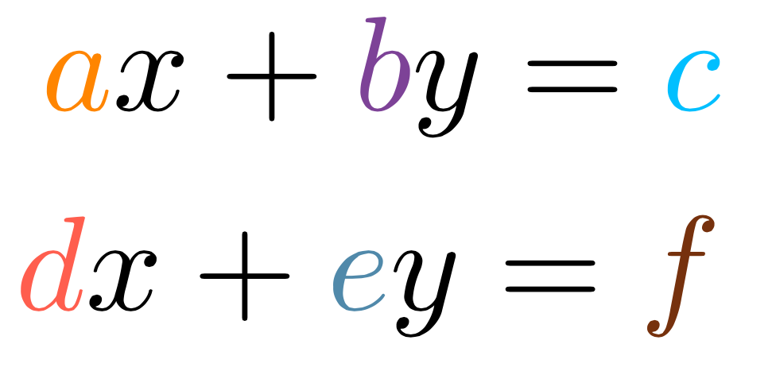
Recall:
Given a system of equations (say 2):

Slide 3
Recall:
We make the matrix equation:

Slide 4
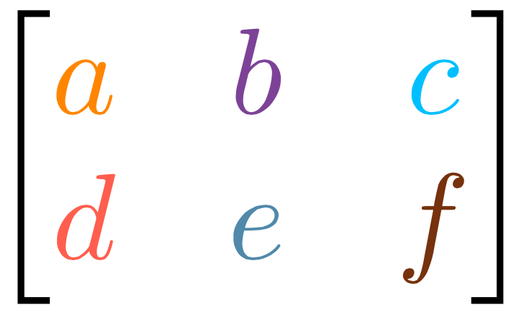
Recall:
Called the Augmented matrix!
We make it even smaller:
We can leave out the Dots

Slide 5
Recall:
We can “operate” on the rows:

Slide 6
Recall:
We can “operate” on the rows:

Slide 7
Recall:
We can “operate” on the rows:

Slide 8
CAN WE SEE THAT WITH NUMBERS ROB?

Slide 9
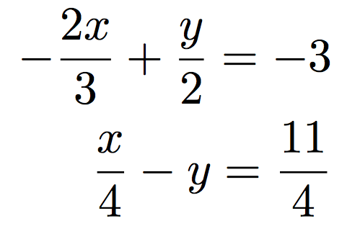
So gimme a system of Equations...

Slide 10
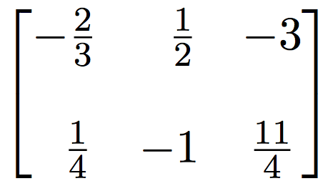
Make it a matrix

Slide 11
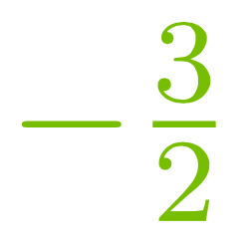
Step 1:
Make top left a 1

Slide 12
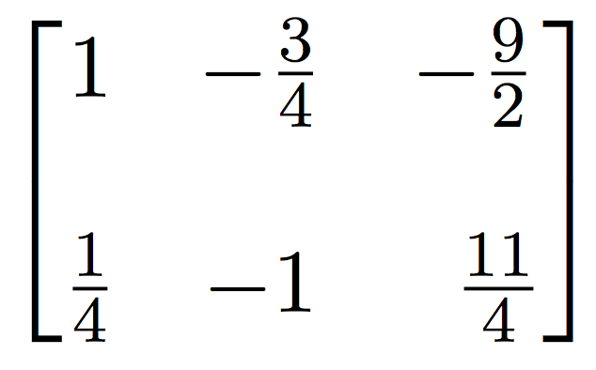
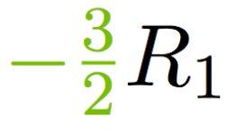
Step 1:
Make top left a 1

Slide 13
Step 2:
Make bottom left a 0

Slide 14
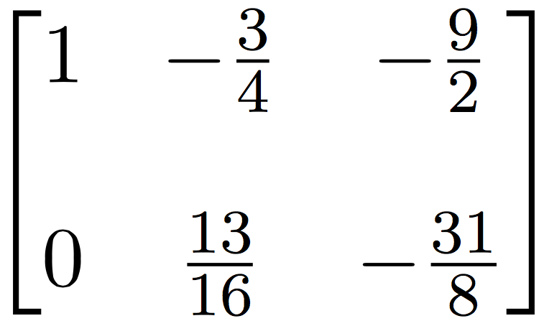
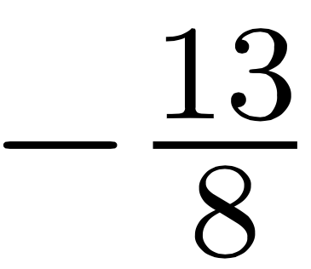
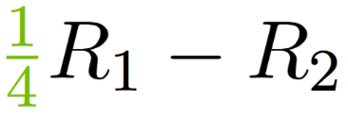
Step 2:
Make bottom left a 0

Slide 15
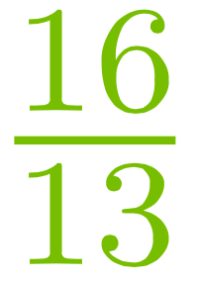
Step 3:
Make bottom middle a 1

Slide 16
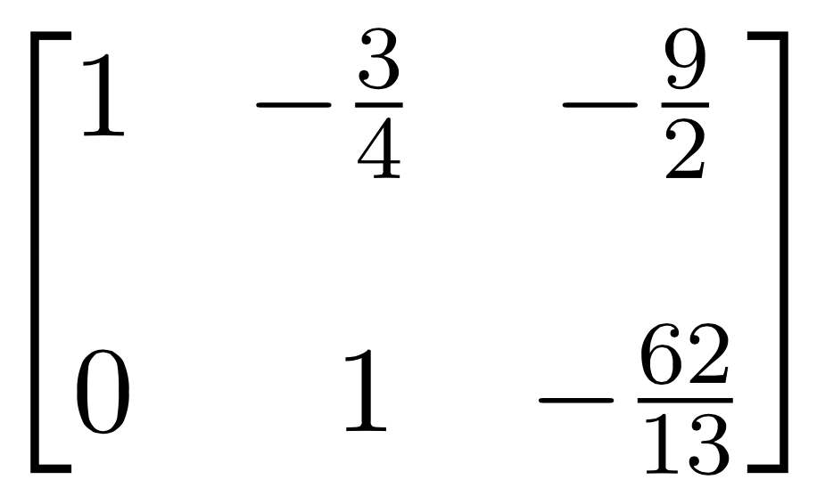
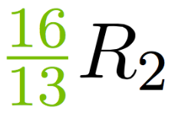
Step 3:
Make bottom middle a 1

Slide 17
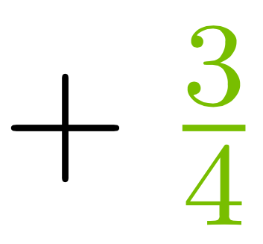
Step 4:
Make top middle a 0

Slide 18
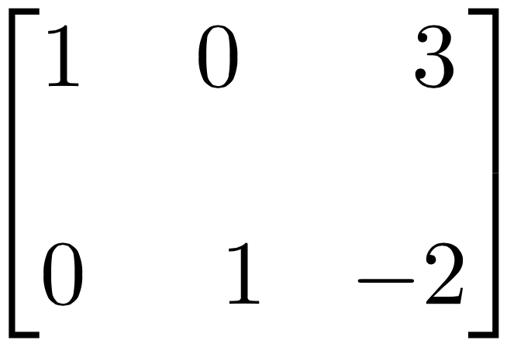
Step 4:
Make top middle a 0

Slide 19
Step 5:
Read Answer!

Slide 20
What if
they don’t intersect?

Slide 21
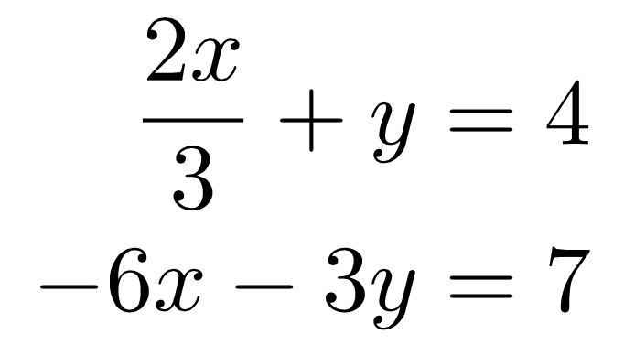
Where dem equations at?

Slide 22
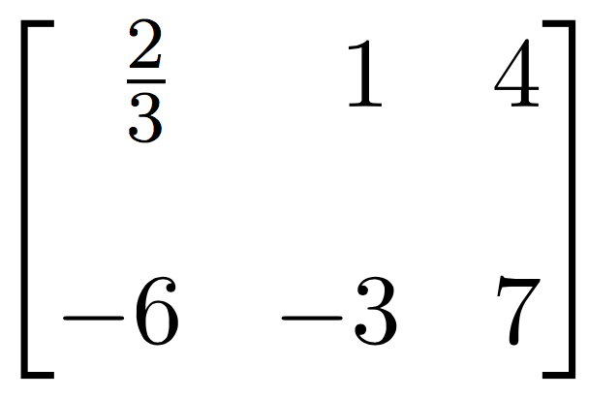
Make it a matrix

Slide 23
Step 1:
Make top left a 1

Slide 24
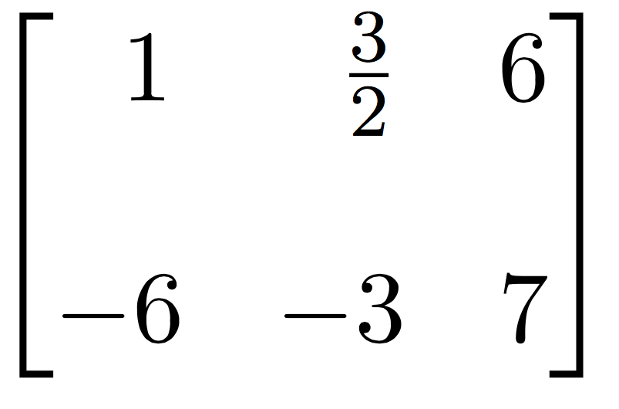
Step 1:
Make top left a 1

Slide 25
Step 2:
Make bottom left a 0

Slide 26
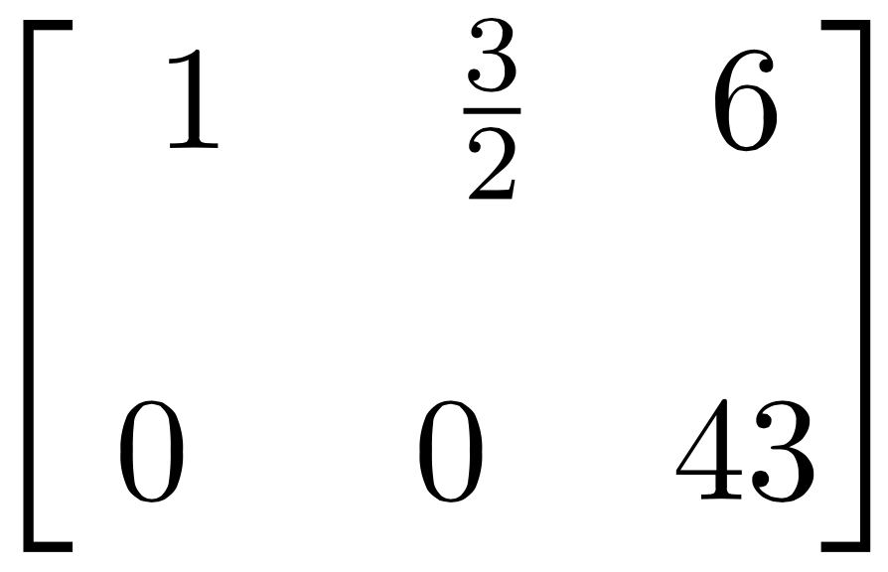
Step 2:
Make bottom left a 0

Slide 27
What??
NO INTERSECTION!

Slide 28
What if
they are the same line?

Slide 29
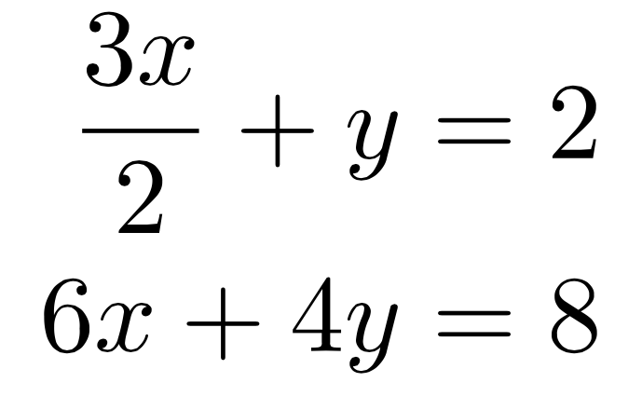
Mo’ Equations...

Slide 30
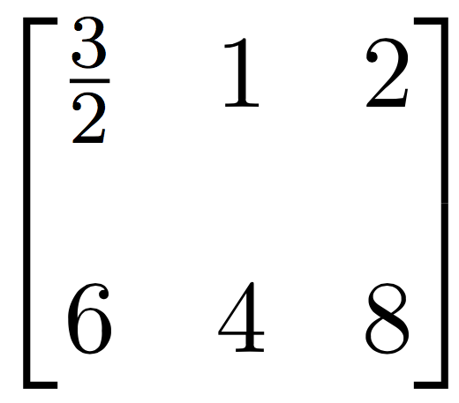
Make it a matrix

Slide 31
Step 1:
Make top left a 1

Slide 32
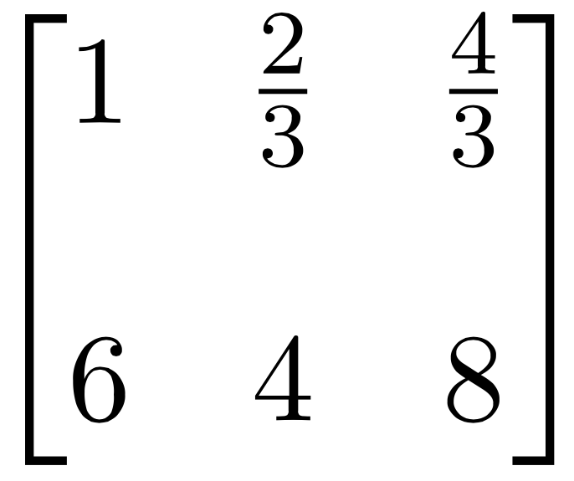
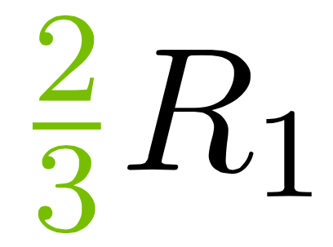
Step 1:
Make top left a 1

Slide 33
Step 2:
Make bottom left a 0

Slide 34
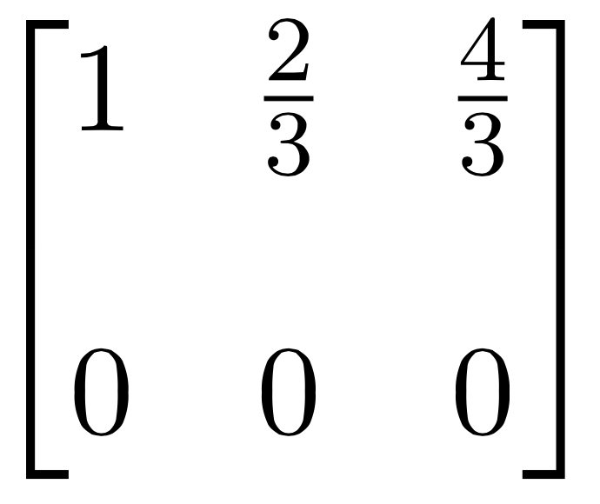
Step 2:
Make bottom left a 0

Slide 35
What??
INFINITE INTERSECTION!

Slide 36
GROUP WORK:
(a)
(b)

Slide 37
GROUP WORK:
(c)
(d)

